Slide 1
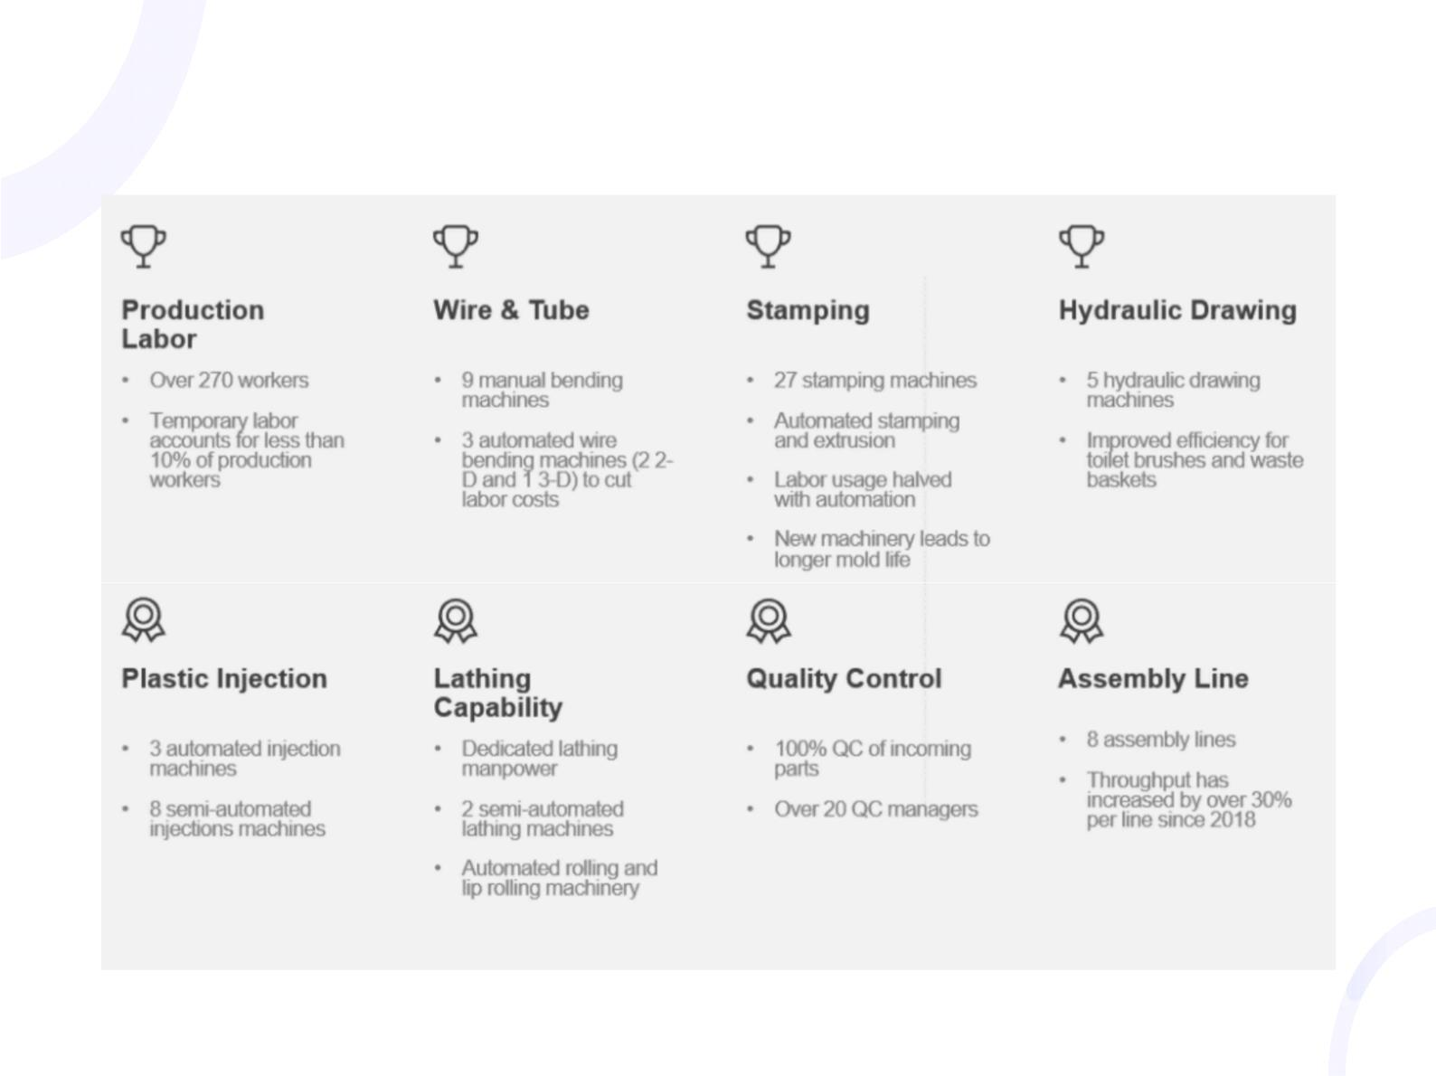
Production process flow diagram display

Slide 2
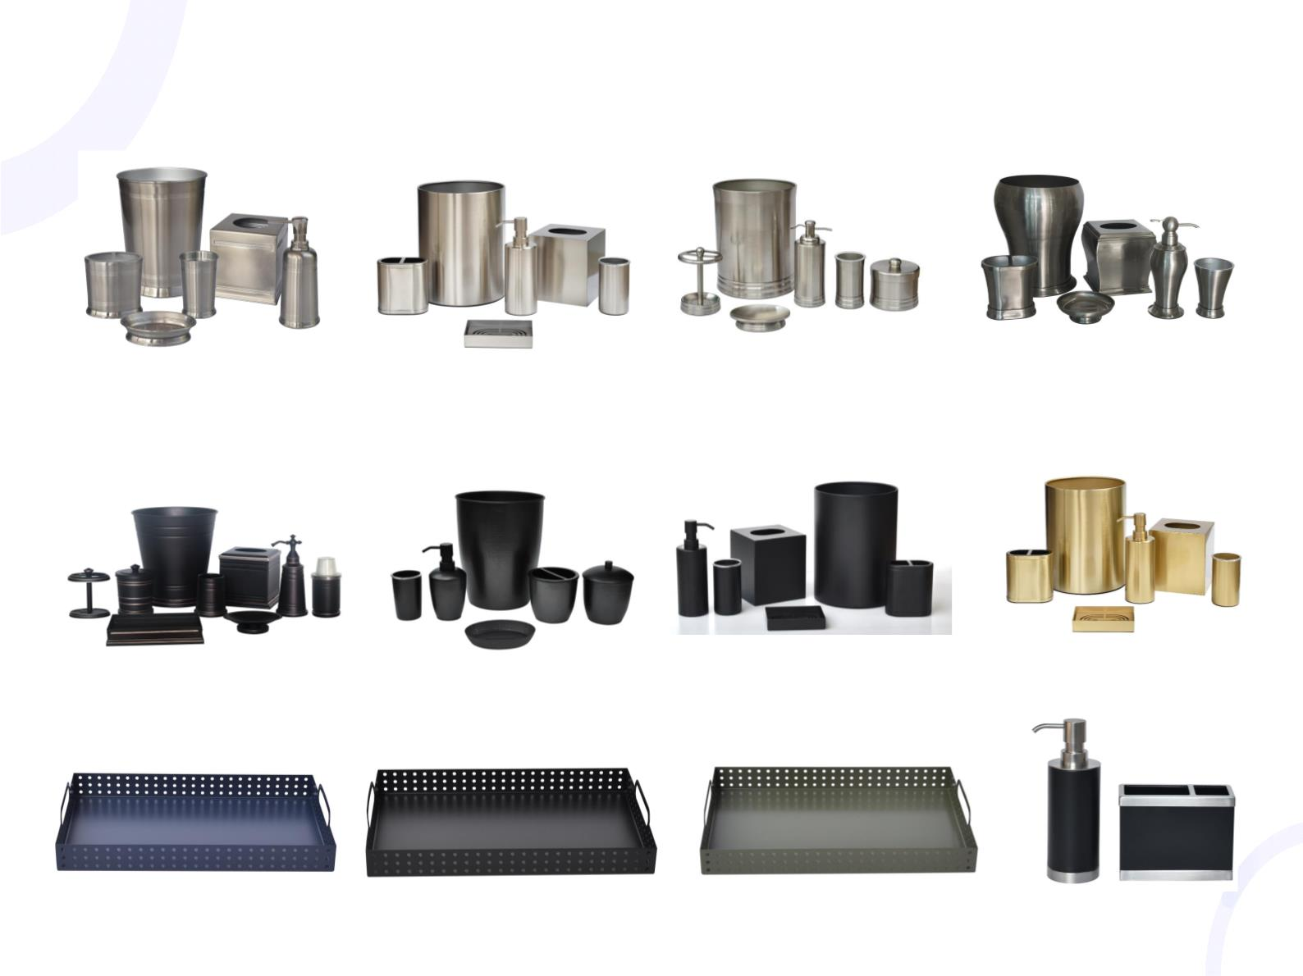
Metal Bath Group set (bath accessories)
I t e m : 3 6 6 3
C o l o r : B r u s h N i c k e l
I t e m : 4 8 1 0
C o l o r : B r u s h N i c k e l
I t e m : 5 6 3
C o l o r : B r u s h N i c k e l
I t e m : 2 4 5 6
C o l o r : B r u s h N i c k e l
I t e m : 4 4 9 7 C
C o l o r : B l a c k
I t e m : 4 8 1 0
C o l o r : B l a c k
I t e m : 4 8 1 0
C o l o r : G o l d
I t e m : 1 0 7 7 B G r o u p
C o l o r : B l a c k
I t e m : 4 4 7 6 T r a y
C o l o r : B l u e
I t e m : 4 4 7 6 T r a y
C o l o r : B l a c k
I t e m : 4 4 7 6 T r a y
C o l o r : G r e y
I t e m : 2 6 0 8
C o l o r : B l a c k

Slide 3
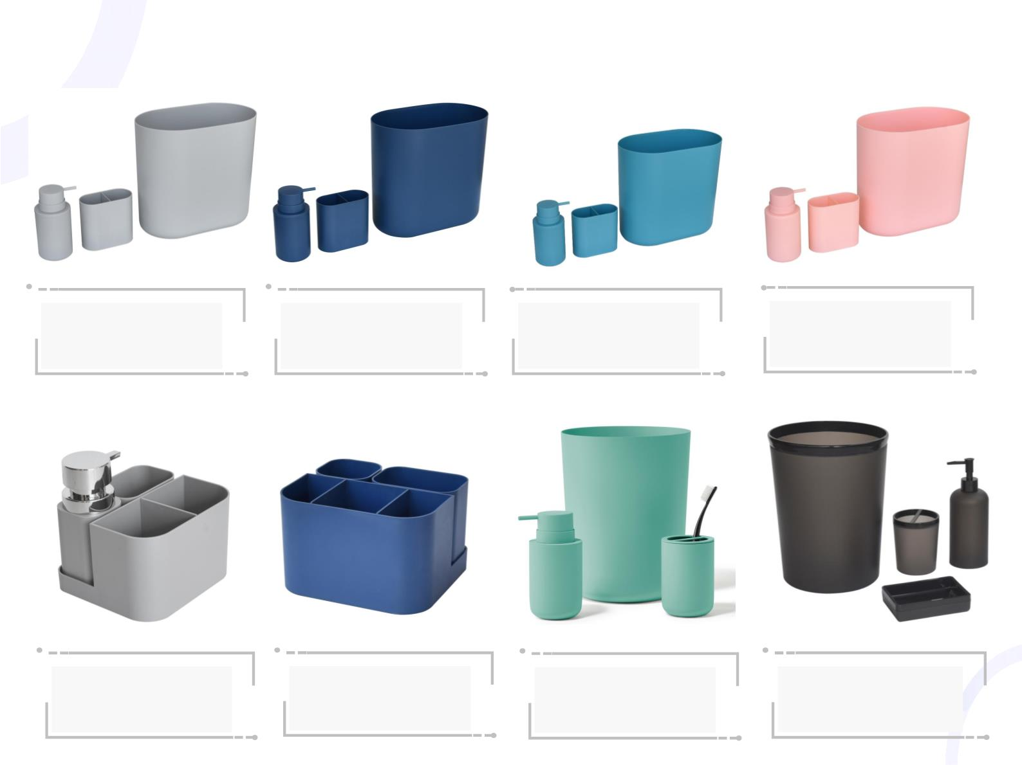
Plastic bathroom related products:
Item: 4819 Modern
Color: Navy
Item: 4819 Modern
Color: Indigo
Item: 4819 Modern
Color: Coral
Item: 4819 Modern
Color: Grey
Application: Bathroom
Application: Bathroom
Application: Bathroom
Application: Bathroom
Item: 4688 Toliet Brush
Color: White
Item: 4686 Plunger
Color: White
Item: 4685 Combo
Color: White
Item: 4685 TISSUE RESERVE
Color: White
Size: 9.14 x 45.97CM
Size: 14.98 x 16.51 x 94.45CM
Size: 27.55 x 16.51 x49.53CM
Size: 6.50 x 16 x 35CM

Slide 4
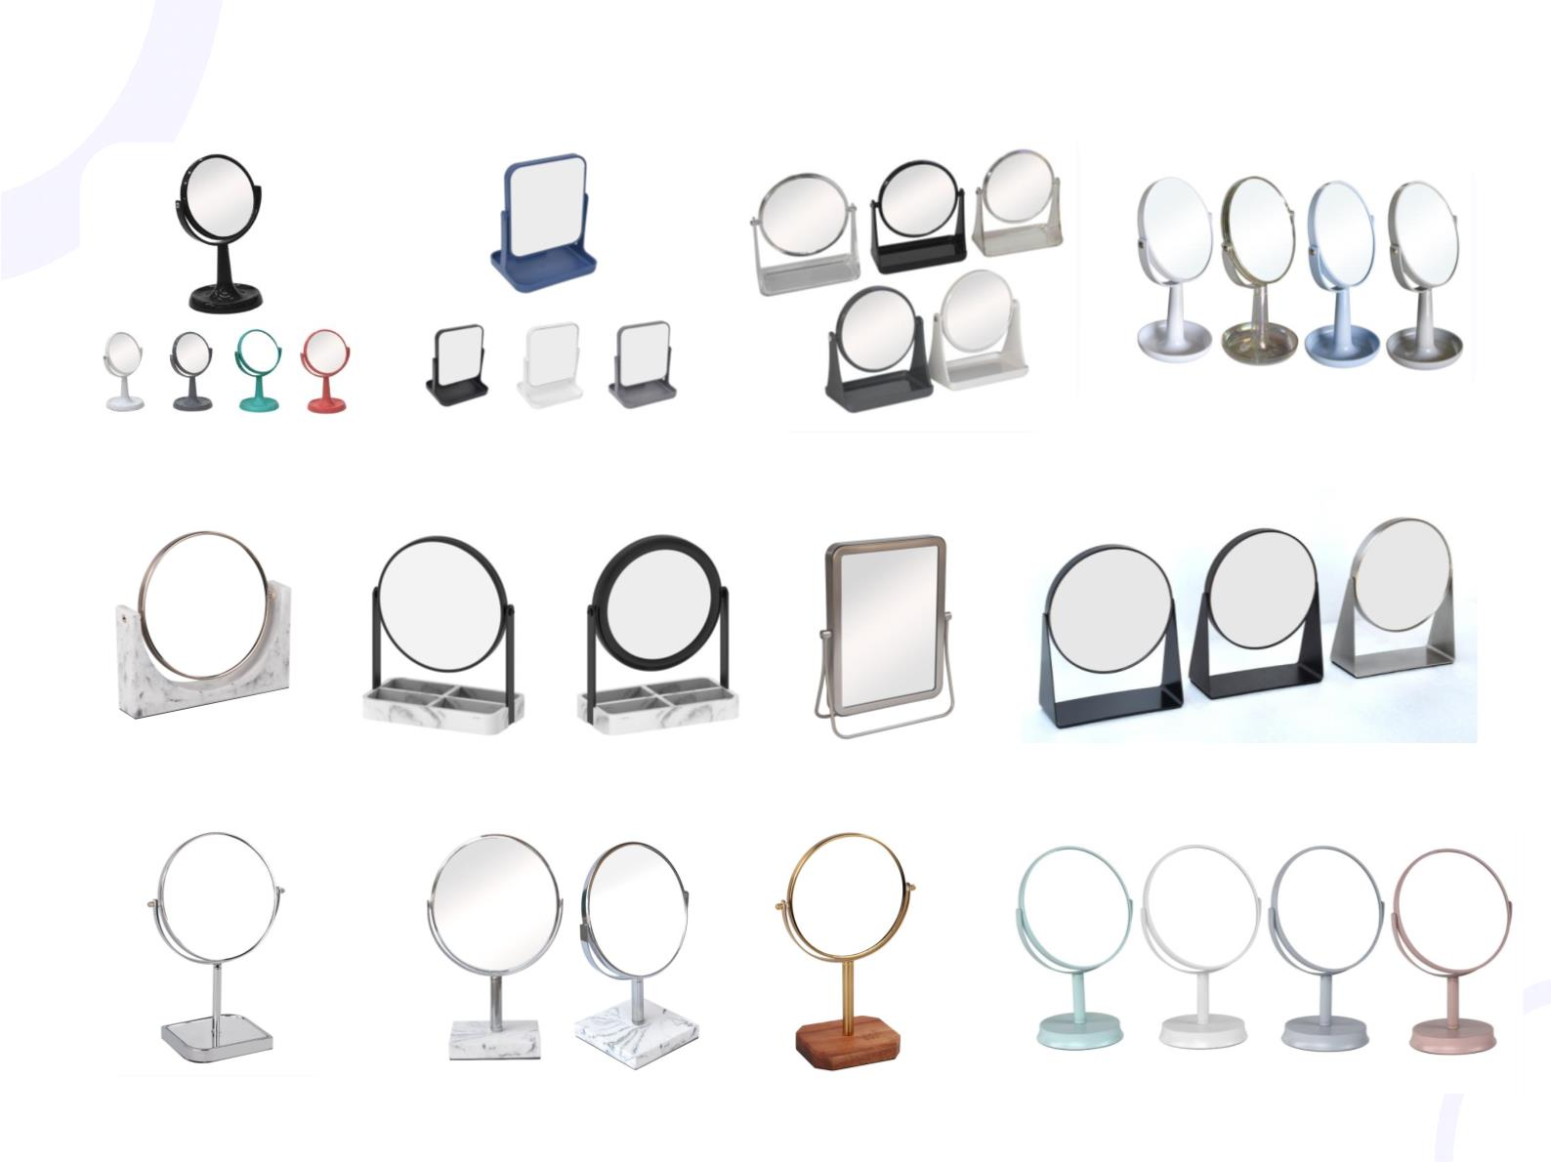
Various Kinds of Mirror:
I t e m : 3 9 2 0
C o l o r : O p t i o n a l
I t e m : 5 7 5
C o l o r : O p t i o n a l
I t e m : 3 9 6 5
C o l o r : O p t i o n a l
I t e m : 3 9 2 0
C o l o r : O p t i o n a l
I t e m : 3 6 0 8
C o l o r : M a r b l e
I t e m : 4 1 4 5
C o l o r : M a r b l e
I t e m : 3 3 4 7
C o l o r : B r u s h N i c k e l
I t e m : M a x w e l l
C o l o r : O p t i o n a l
I t e m : 3 6 0 6
C o l o r : S l i v e r M e t a l
I t e m : 3 4 8 2
C o l o r : M a r b l e
I t e m : 3 6 0 3
C o l o r : M e t a l + w o o d
I t e m : 1 4 0 5 B
C o l o r : O p t i o n a l

Slide 5
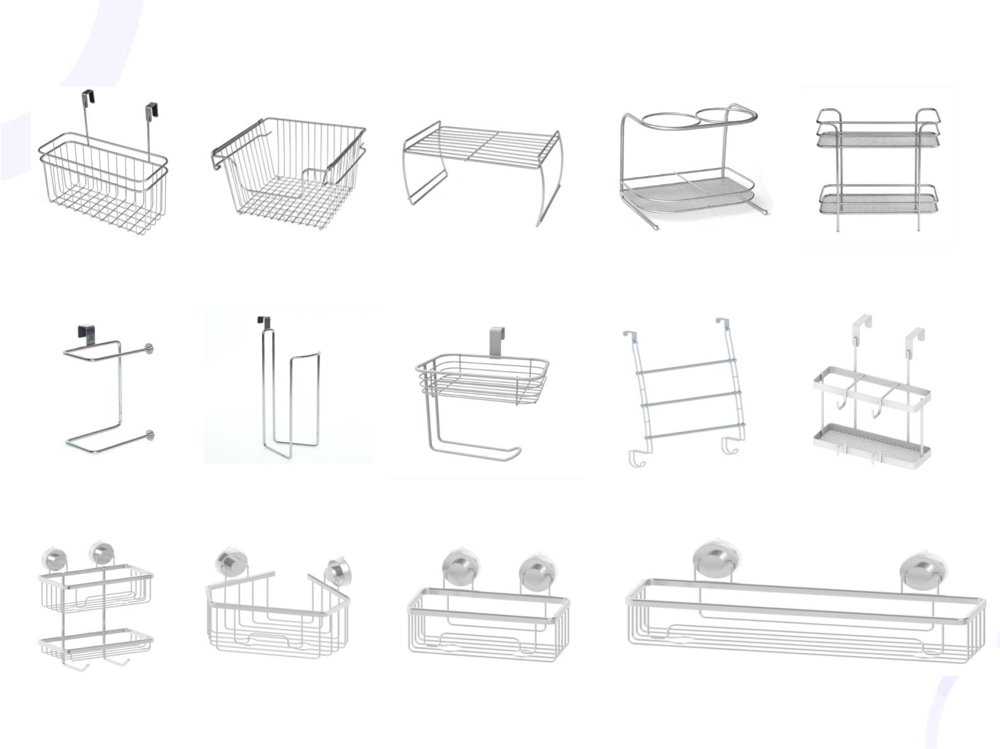
Wire Products:
I t e m : 4 4 2 1
C o l o r : S l i v e r
I t e m : 4 3 9 4
C o l o r : S l i v e r
I t e m : 4 3 9 0
C o l o r : S l i v e r
I t e m : 4 4 2 0
C o l o r : S l i v e r
I t e m : 4 3 9 5
C o l o r : S l i v e r
I t e m : 4 6 2 4
C o l o r : S l i v e r
I t e m : 4 6 2 3
C o l o r : S l i v e r
I t e m : 4 6 2 3
C o l o r : S l i v e r
I t e m : 4 4 6 0
C o l o r : S l i v e r
I t e m : 3 1 3 5 C
C o l o r : S l i v e r

Slide 6

Home Storage Products:
I t e m : 4 2 1 6 R a c k
I t e m : 2 7 1 3 C l o s e t c a r t
Item:4288
Wood&Metal
Cart
I t e m : 4 T i e r S h o e R a c k
I t e m : 5 T i e r S h oe R a c k

Slide 7
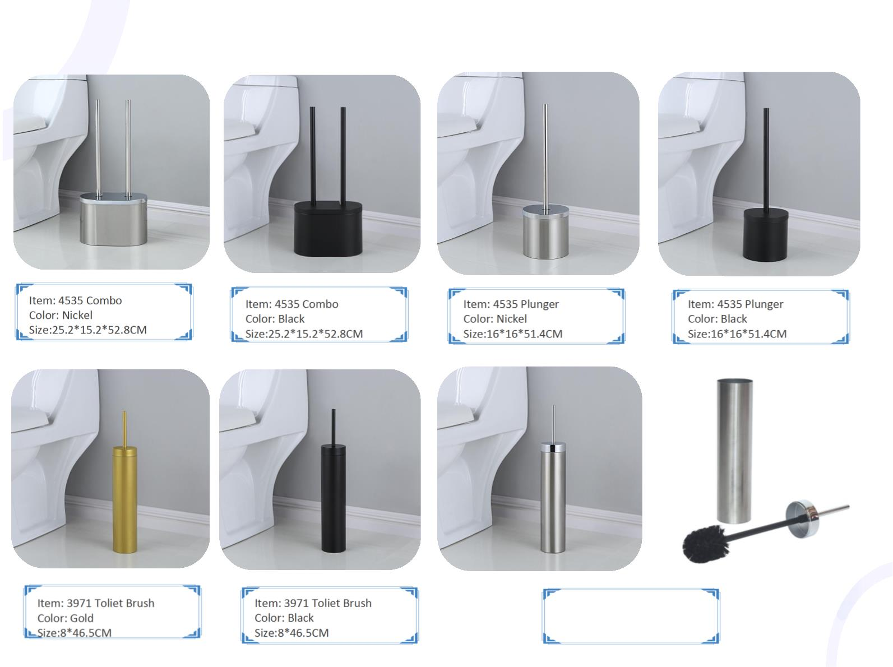
Metal Toliet Brush, Plunger & Combo
Item: 4535 Combo
Color: Nickel
Size:25.2*15.2*52.8CM
Item: 4535 Combo
Color: Black
Size:25.2*15.2*52.8CM
Item: 4535 Plunger
Color: Nickel
Size:16*16*51.4CM
Item: 4535 Plunger
Color: Black
Size:16*16*51.4CM
Item: 3971 Toliet Brush
Color: Gold
Item: 3971 Toliet Brush
Color: Black
Item: 3971 Toliet Brush
Color: Nickel
Size:8*46.5CM
Size:8*46.5CM
Size:8*46.5CM

Slide 8
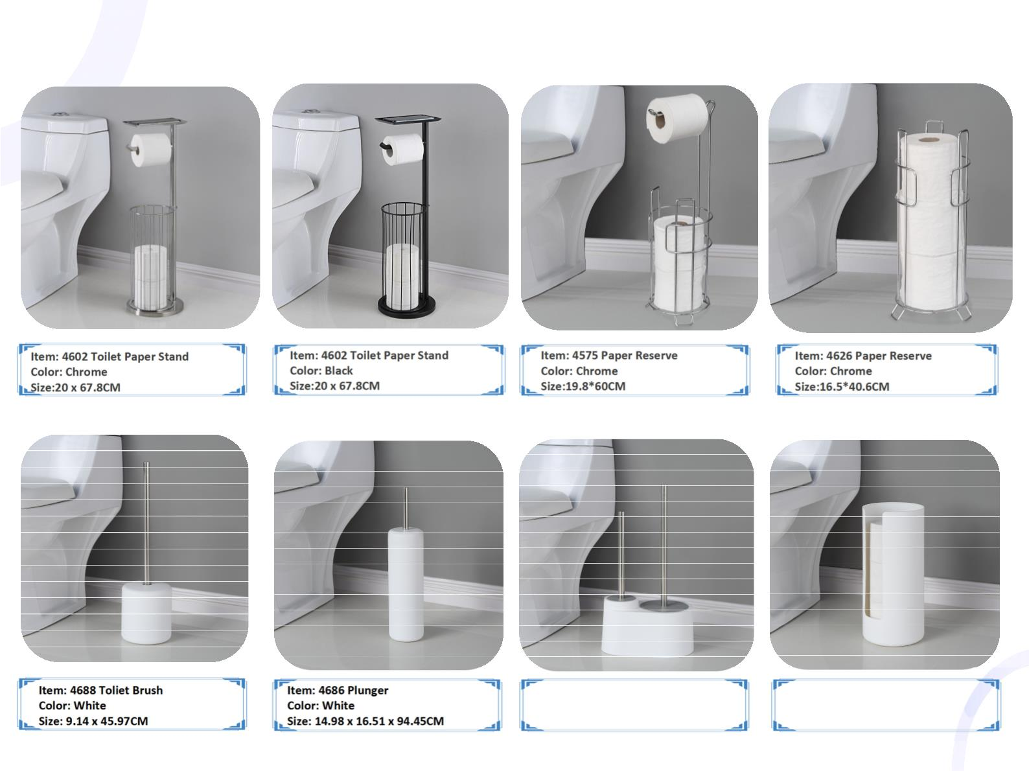
Metal Tissue Stand & Holder:
Item: 4602 Toilet Paper Stand
Color: Chrome
Size:20 x 67.8CM
Item: 4602 Toilet Paper Stand
Color: Black
Size:20 x 67.8CM
Item: 4575 Paper Reserve
Color: Chrome
Size:19.8*60CM
Item: 4626 Paper Reserve
Color: Chrome
Size:16.5*40.6CM
Item: 4688 Toliet Brush
Color: White
Size: 9.14 x 45.97CM
Item: 4686 Plunger
Color: White
Size: 14.98 x 16.51 x 94.45CM
Item: 4685 Combo
Color: White
Size: 27.55 x 16.51 x49.53CM
Item: 4685 TISSUE RESERVE
Color: White
Size: 6.50 x 16 x 35CM

Slide 9
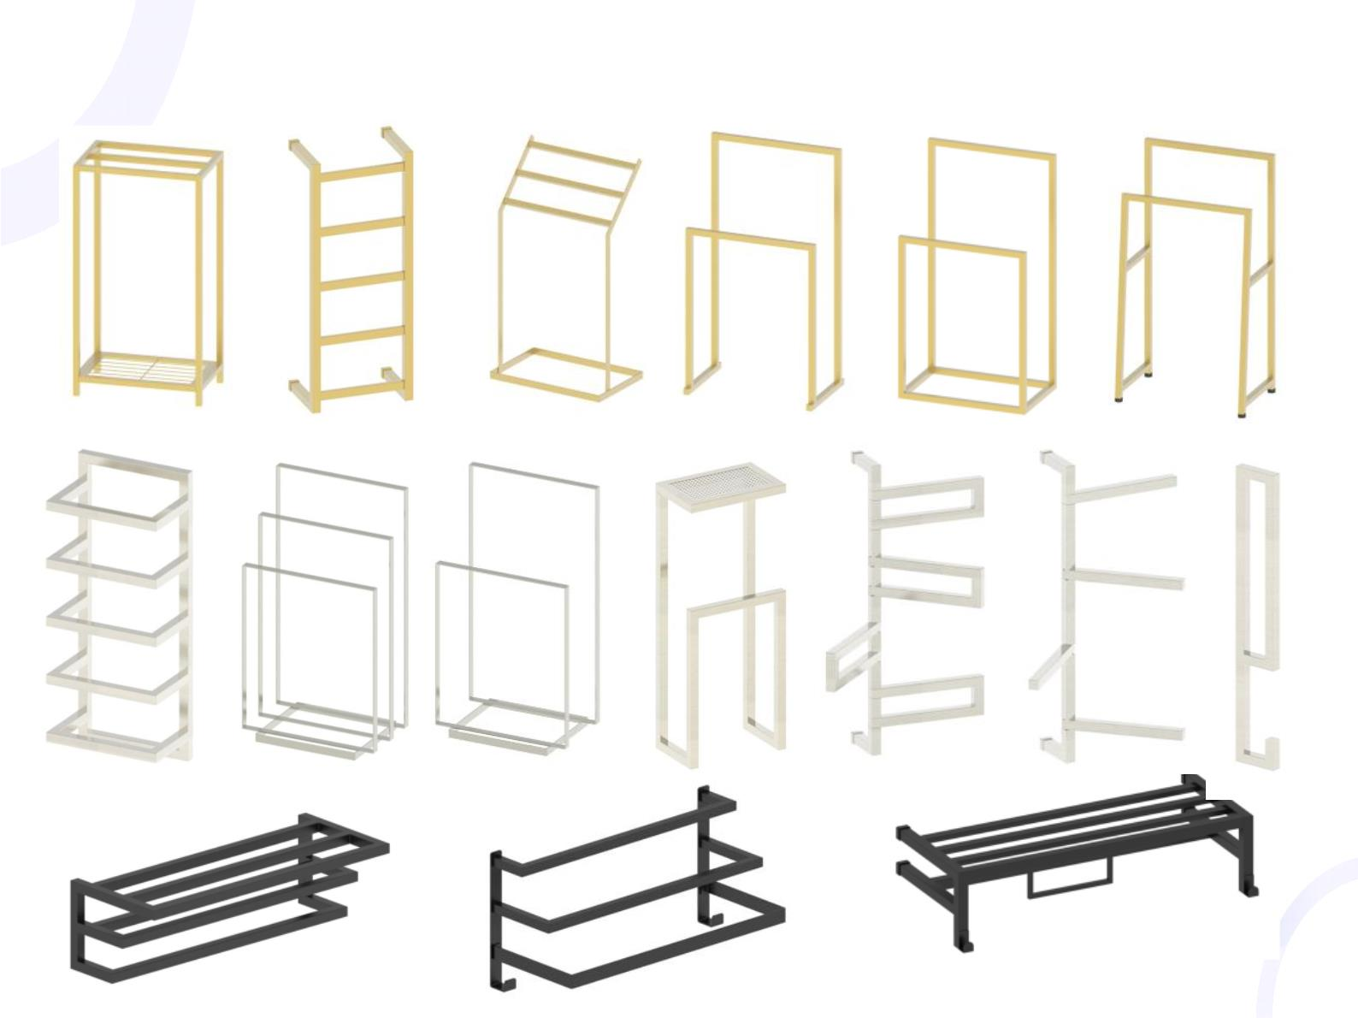
Towel Rack

Slide 10
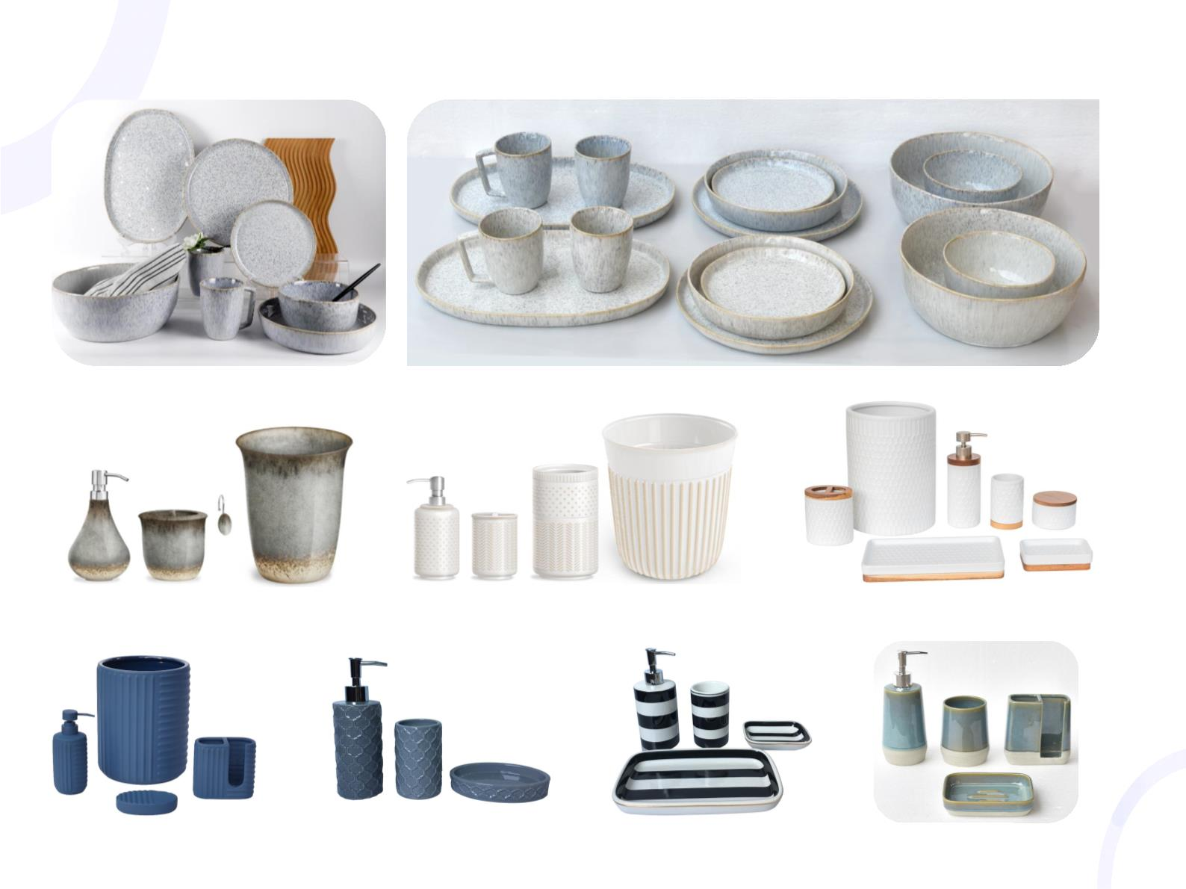
Ceramic Series:
I t e m : M e i k e S t u d i o 3 B
C o l o r : B e i g e & G r e y
I t e m : B H G 0 6 - 1 1 - 1 9
C o l o r : R e a c t i v e C e r a m i c
I t e m : B H G 0 6 - 1 1 - 1 9
C o l o r : M i x T e x t u r e d
I t e m : Z U 2 0 2 2 0 3 0 7
C o l o r : W h i t e & W o o d
I t e m : 5 6 1 R u b b e r
C o l o r : N a v y
I t e m : 4 0 0 1
C o l o r : N a v y T e x t u r e d
I t e m : 2 9 4 3
C o l o r : B l a c k & W h i t e
I t e m : M K Z F l o w
C o l o r : B e i g e & B l u e

Slide 11
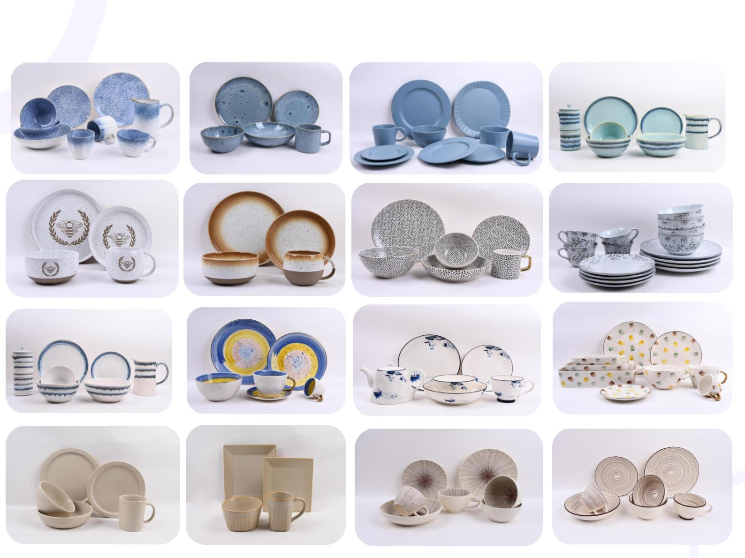
Ceramic Glossy Reactive Glazing Finishing

Slide 12
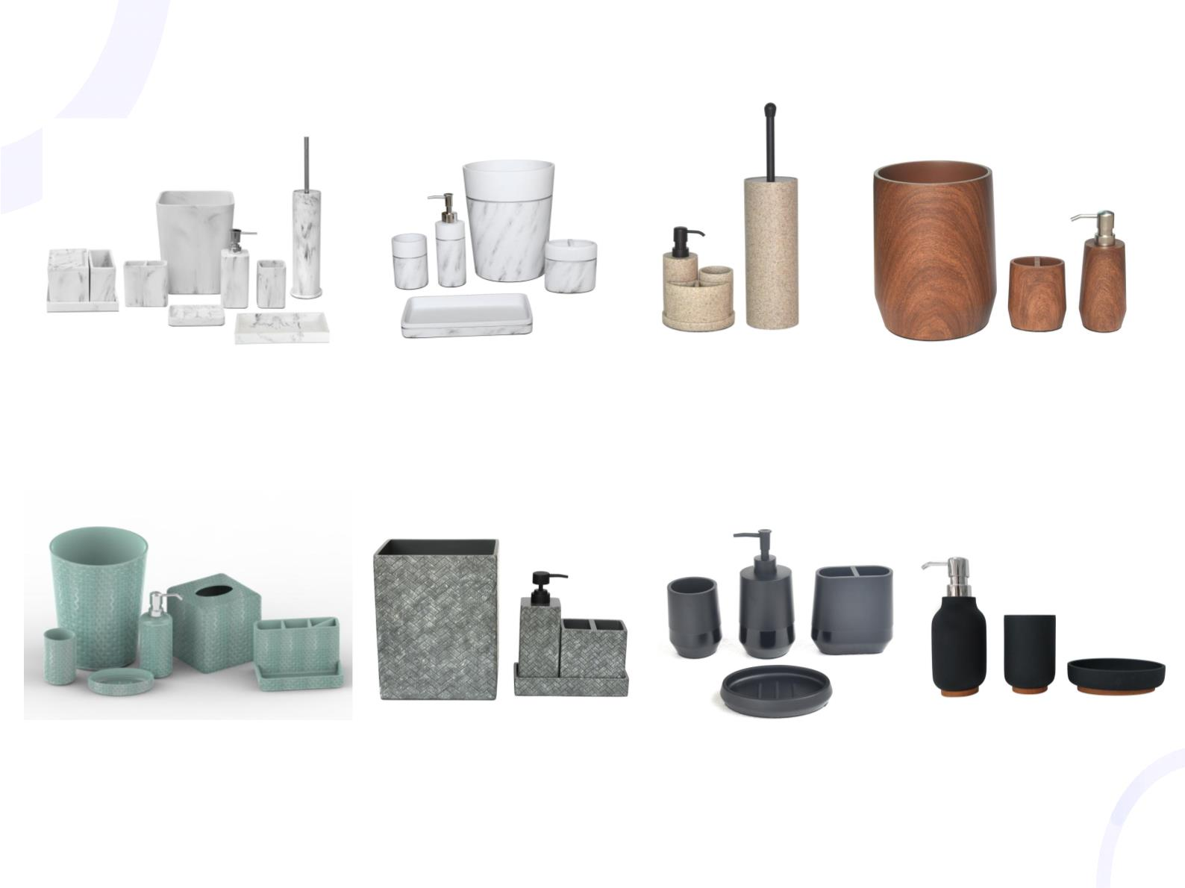
Polyresin Series:
I t e m : 7 - p i e c e s s e t
C o l o r : M a r b l e w h i t e
I t e m : 3 9 0 7 r e s i n
C o l o r : M a r b l e w h i t e
I t e m : S a n d s t o n e
C o l o r : B e i g e
I t e m : 4 3 0 0 M e l o d y
C o l o r : W o o d f i n i s h
I t e m : 6 - p i e c e s s e t
C o l o r : A q u a
I t e m : Z T 2 0 2 0 0 9 2 3
C o l o r : g r e y
I t e m : 4 - p i e c e s s e t
C o l o r : B l a c k
I t e m : 3 3 5 3 r e s i n
C o l o r : B l a c k & B a m b o o

Slide 13
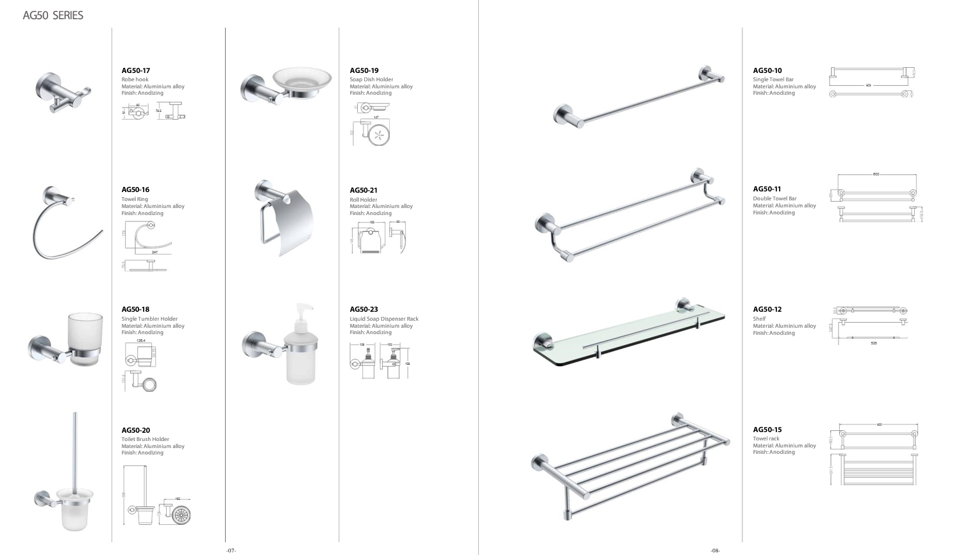
Bath accessories:

Slide 14
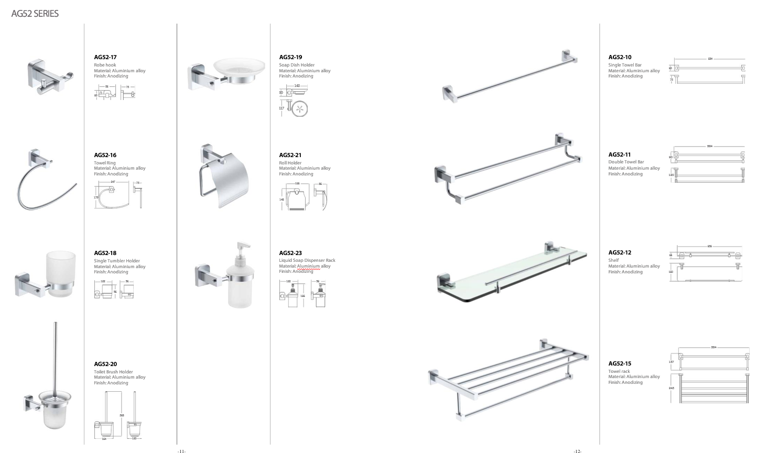
Bath accessories:

Slide 15
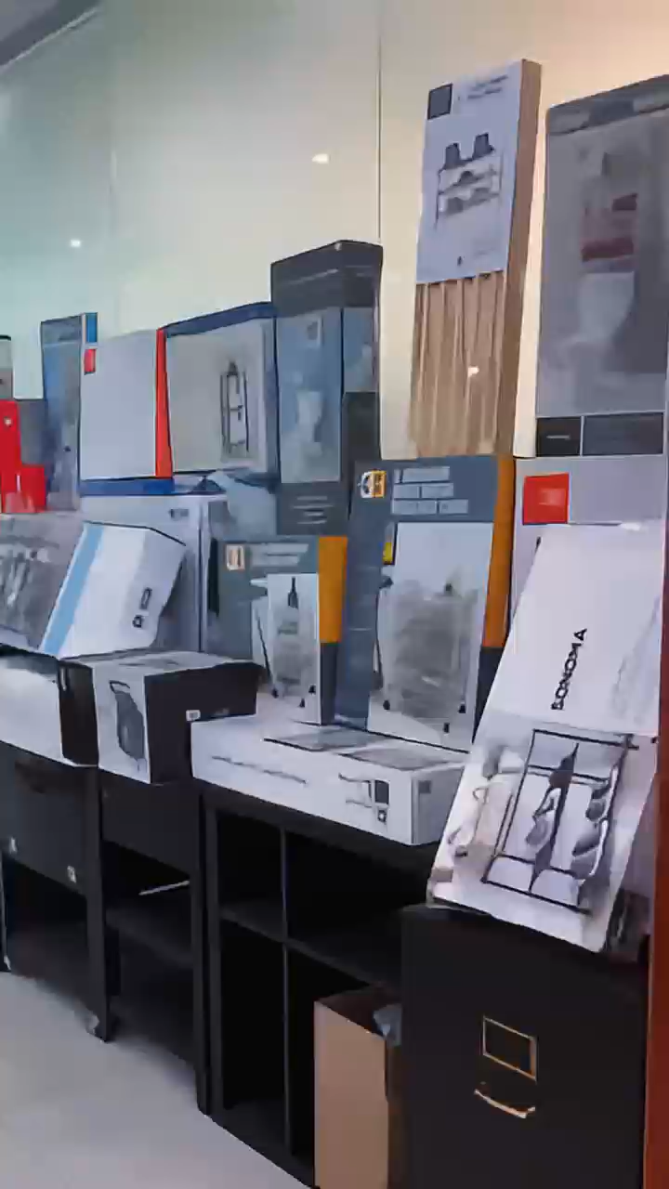
Showroom

